Slide 1
SQL Programming
Data Control Language

Slide 2
Module 14: DCL Page A-1: Intro
SQL Statement Types:
DQL – Data Query Language
DML – Data Manipulation Language
DDL – Data Definition Language
DCL – Data Control Language
In this module we concern ourselves with some of the security aspects of database operations.
We’ll be looking at the Data Control Language statements, and the magic word here is ‘control’.
These statements help the database designer, programmer, and user control who has access to the various database objects that have been created.

Slide 3
Module 14: DCL Page B-1: People in the DB Environment
Let’s consider a college campus as the setting for our discussion on database security.
As a first step, let’s identify the players.
Who are the people on campus?

Slide 4
Module 14: DCL Page B-2: People in the DB Environment
Let’s consider a college campus as the setting for our discussion on database security.
As a first step, let’s identify the players.
Who are the people on campus?
Students
Teachers (faculty)
Police
Cafeteria workers
Custodians
Librarians
Managers
….

Slide 5
Module 14: DCL Page B-3: People in the DB Environment
This is a pretty good listing of people, but now let’s consider the question from the perspective of computing systems, and rephrase our inquiry as to: “Who are the different information system users on campus, and what computing services do they need”?

Slide 6
Module 14: DCL Page B-4: People in the DB Environment
What computing services do students need?

Slide 7
Module 14: DCL Page B-5: People in the DB Environment
What computing services do students need?
Access to their own student records.
Use of the class registration system.
Access to the library, ...
What computing services do faculty need?

Slide 8
Module 14: DCL Page B-6: People in the DB Environment
What computing services do students need?
Access to their own student records.
Use of the class registration system.
Access to the library.
What computing services do faculty need?
Access to class schedule.
Use of curriculum development system.
Access to their own personnel records.
Access to the library system, ...
What computing services do librarians need?

Slide 9
Module 14: DCL Page B-7: People in the DB Environment
What computing services do students need?
Access to their own student records.
Use of the class registration system.
Access to the library.
What computing services do faculty need?
Access to class schedule.
Use of curriculum development system.
Access to their own personnel records.
Access to the library system, ...
What computing services do librarians need?
Access to their own personnel records.
Access to class schedule.
Use of the library system, …

Slide 10
Module 14: DCL Page B-8: People in the DB Environment
As we reconsider the question of information system users, we begin to see an emerging pattern of usage.
All of the systems that we described have a public side to them, and a private side to them. And our classification of users will be based on this distinction.
Those users who have access to the private side of the system are generally known as: owners or maintainers of the system.
Those users who have access to the public side of an application are generally referred to as: users, clients, or customers.

Slide 11
Module 14: DCL Page B-9: People in the DB Environment
Owners of an information system are responsible for the system, and they determine who else may access or use their system.
Users of an information system avail themselves of those services, and in most cases, these users must have been given permission to use these systems.
So how do we go about granting permissions?

Slide 12
Module 14: DCL Page C-1: Granting Privileges
The GRANT command allows the owner of a schema object to specify how other database users may access or modify that object.
The syntax for the GRANT statement is:
GRANT privilege_type
ON object_name
TO user_list;
This looks rather straightforward.
The user_list is probably a list of user names (eg. bbergin, F3S3, insc033, …)
The object_name is probably the name of a table or view, (or some other schema object).
But what are privilege types?

Slide 13
Module 14: DCL Page C-2: Privilege Types
Privilege types are the actions you can perform on an object.
Here’s a question for you. If the object were a table, what kinds of actions might you need to perform on that table?
(You should be able to come up with at least four actions)

Slide 14
Module 14: DCL Page C-3: Privilege Types
Privilege types are the actions you can perform on an object.
Here’s a question for you. If the object were a table, what kinds of actions might you need to perform on that table?
(You should be able to come up with at least four actions)
(Hint: CRUD)

Slide 15
Module 14: DCL Page C-4: Privilege Types
Privilege types are the actions you can perform on an object.
Here’s a question for you. If the object were a table, what kinds of actions might you need to perform on that table?
(You should be able to come up with at least four actions)
That’s right!
SELECT
INSERT
UPDATE
DELETE

Slide 16
Module 14: DCL Page C-5: Granting Privileges
So, if I wanted to allow the user SCOTT to be able to read one of the tables in my schema, say the movies table, I could grant him permission with the following command:
GRANT select ON movies TO scott;
If Scott should also have permission to update that table, I could subsequently issue this command:
GRANT update ON movies TO scott;
Or, initially, I could have executed this command:
GRANT select, update ON movies
TO scott;

Slide 17
Module 14: DCL Page C-6: Revoking Privileges
Privileges are revoked, or taken away, in a similar fashion.
REVOKE privilege_list
ON object_name
FROM user_list;
For example:
REVOKE update ON movies FROM scott;

Slide 18
Module 14: DCL Page C-7: MySQL User-Lists
MySQL has an “interesting” way of specifying the user list, and it does provide a degree of specificity that we don’t see with Oracle’s implementation.
MySQL can “lock down” user access not only by user name, but also by the host from which they are accessing the system. The general form of the user_list entry in MySQL is:
username@hostname
If I wanted to give username: SCOTT, from system cisdb01.msjc.edu access to the movies table, the command would look like this:
GRANT SELECT ON movies
TO ‘scott’@’cisdb01.msjc.edu’

Slide 19
Module 14: DCL Page C-8: MySQL User-Lists
If I only wanted to give access to local users, I could use this abbreviation for the local system.
GRANT SELECT ON movies
TO ‘scott’@’localhost’
Do note, in each of these examples, that the username is enclosed in quotes, the hostname is enclosed in quotes, and the ampersand (@) is NOT enclosed in quotes.

Slide 20
Module 14: DCL Page D-1: Granularity
Privileges can be bestowed down to the column level, but they cannot (yet) be bestowed to the row level.
The syntax for column level privileges is
GRANT privilege_list (column_list)
ON table_name
TO user_list;
For example:
GRANT update (name)
ON students
TO scott;
This syntax is a little bit counter-intuitive to me.

Slide 21
Module 14: DCL Page D-2: Granularity ?
It seems to me that it would make more sense for the syntax to be something like:
GRANT privilege_list
ON table_name (column_list)
TO user_list;
For example:
GRANT update ON students (name)
TO scott;
This AIN’T the Way It Works!
I can only guess that the syntax is written as it is so that the user can bestow a variety of privileges in a single statement. For example:
GRANT select(name, majr),
update(name),
insert(sid, name)
ON students TO scott;

Slide 22
Module 14: DCL Page E-1: Public
When the owner of an object wants to give away certain privileges on that object to everybody using an Oracle database, there is a short cut that can be used (in lieu of typing in everyone’s username).
The shortcut, or special value that can be used, is the keyword PUBLIC.
For example, if you wanted everyone on the system to have read access to your movies table, you could issue this command:
GRANT select ON movies TO PUBLIC;

Slide 23
Module 14: DCL Page E-2: ‘Public’ in MySQL
We’ve seen that the general form of user_list entries in MySQL is something like:
username@hostname
How do you think we could implement a ‘public’ permission with this scheme?
>

Slide 24
Module 14: DCL Page E-3: ‘Public’ in MySQL
We’ve seen that the general form of user_list entries in MySQL is something like:
username@hostname
How do you think we could implement a ‘public’ permission with this scheme?
We’d have to come up with something that could accommodate ‘anything’ for the username, as well as ‘anything’ for the hostname.
Hmmm…
>

Slide 25
Module 14: DCL Page E-4: ‘Public’ in MySQL
We’ve seen that the general form of user_list entries in MySQL is something like:
username@hostname
How do you think we could implement a ‘public’ permission with this scheme?
We’d have to come up with something that could accommodate ‘anything’ for the username, as well as ‘anything’ for the hostname.
Hmmm…
The MySQL solution is rather intuitive (once you see it ☺)
GRANT SELECT ON movies
to username@’%’;

Slide 26
Module 14: DCL Page E-5: ‘Public’ in MySQL
Now this covers “any” host
GRANT SELECT ON movies
to username@’%’;
We could be less generous and only give access to users in our ‘company’
GRANT SELECT ON movies
to username@ ’%.msjc.edu’;
Or even restrict access to a particular domain
GRANT SELECT ON movies
to username@ ’%.edu’;

Slide 27
Module 14: DCL Page E-6: ‘Public’ in MySQL
But I’ve been a little vague about the username part. And one would ‘hope’ that MySQL would use the same ‘trick’ to accommodate usernames.
Unfortunately, MySQL does not permit wildcards in usernames.
So the trick with the username part of it, is to pass it an empty string (‘’).
For example:
GRANT SELECT ON movies
to ‘’ @ ’%.msjc.edu’;
GRANT SELECT ON movies
to ‘’ @ ’%’;

Slide 28
Module 14: DCL Page F-1: Objects and Privileges
In addition to the CRUD operations against tables and views, there are other privileges that can be bestowed on tables.
There are also other objects for which privileges can be granted.

Slide 29
Module 14: DCL Page F-2: Objects and Privileges
The ability to reference a table, via a foreign key reference, is a specific privilege that must be granted for anyone other than the table owner to use.
If table referencing were a ‘wide open’ feature of a database, can you imagine how a programmer might ‘reverse engineer’ the database, and discover the names of all of the tables in a user’s account?
It would also be trivial to ‘reverse engineer’ all of the primary keys in a referenced table.

Slide 30
Module 14: DCL Page F-3: Objects and Privileges
A USAGE privilege can be granted by a user who wishes to share any of these schema objects:
domains and user defined data types,
character sets and collations, and
translations.
And an EXECUTE privilege can be bestowed on stored procedures. Stored procedures are programs that are stored (and available) in the database.

Slide 31
Module 14: DCL Page G-1: Creating Users
Users and their schemas are simply objects as far as the database is concerned, and in the Oracle world, new users are created with the CREATE command.
CREATE USER user_name
IDENTIFIED BY password;
Users are removed from the system with the DROP command.
DROP USER user_name;
But you should be very careful with this command. When a user is dropped, all of the objects in their schema (tables, views, …) are removed from the database.

Slide 32
Module 14: DCL Page G-2: Creating Users
There’s a common security precaution that is taken in many computing establishments.
When a programmer leaves the company, they are escorted off the premises by security, and their computing accounts are immediately deleted.
On one occasion the security team was a little too gung ho, and didn’t completely check the computer system before deleting the programmer’s accounts.
As it turns out, this programmer was the lead developer for a particular application, and all of the tables for that application were stored in his schema (user area). When his account was deleted from the system, all of the schema objects in his account were automatically dropped by the database, crashing the entire application!
It took some time to restore the application.
What might have been a better procedure would have been for security to simply change the password on the account, rather than deleting the account.

Slide 33
Module 14: DCL Page G-3: Passwords
User passwords are changed with the ALTER statement.
ALTER USER user_name
IDENTIFIED BY password;

Slide 34
Module 14: DCL Page H-1: User Management
To simplify user management in a database environment, the database administrator will often develop roles.
A role is a simply a collection of privileges that can be passed on to a user.
Let’s return to the campus scenario that we used at the beginning of this module. The campus database system is probably comprised of a couple hundred database tables.
Imagine the work that would be involved if each of the table grants in this system had to be issued, one at a time, to each user. The database administrator would spend all of her time in managing users and user accounts.

Slide 35
Module 14: DCL Page H-2: User Management
Instead of this one-at-a-time approach, database administrators define a series of roles for each of the kinds of users in the organization. At it’s most simple level, there would be two roles for each application, a private role and a public role.
The public roles would allow read access, and the private roles would allow update, insert and delete privileges.
For example, the library_public_role would receive SELECT privileges on the tables in the library system, and this role would be granted to everyone on campus. The library_private_role would receive UPDATE, INSERT, and DELETE privileges on the library system tables, and this role would be granted only to the librarians and technicians that work in the library.

Slide 36
Module 14: DCL Page H-3: User Management
These roles would be created with the CREATE command.
CREATE ROLE role_name;
For example:
CREATE ROLE library_public_role;
CREATE ROLE library_private_role;
And the appropriate object privileges would be assigned to these roles.
For example:
GRANT select ON books
TO library_public_role;
GRANT select ON periodicals
TO library_public_role;
…
These roles would then be bestowed to particular users on campus:
GRANT library_public_role TO bbergin;

Slide 37
Module 14: DCL Page H-4: User Management
As you would imagine, roles are removed from the database with the DROP command.
As follows:
DROP ROLE library_public_role;
DROP ROLE library_private_role;

Slide 38
Module 14: DCL Page H-5: MySQL and Roles
Note: MySQL does NOT yet support Roles.

Slide 39
Module 14: DCL Page H-6: System Privileges
All of the privileges that we have discussed so far have been object privileges.
These were privileges that could be granted on a specific object in the database.
As a SQL programmer you should be aware that there is another category of privileges, known as system privileges. System privileges are generally granted by the database administrator, and confer ‘access’, or database rights to the user.
For example, the ability to connect to the database is a system privilege. The ability to create database objects is also a system privilege.

Slide 40
Module 14: DCL Page J-1: Technical Duties
So far we’ve identified two classes of users:
owners, and
clients
The owners get access to the “private” side of the application which allows them to maintain (ie. Update, create, and delete) the data.
The clients get access to the “public” side of the application which permits them to view the data.

Slide 41
Module 14: DCL Page J-2: Technical Duties
It’s up to the owners of the data to determine WHO gets WHAT level of access to WHICH data.
Those permissions are bestowed via the GRANT command.
And although the GRANT command is pretty simple to use, ‘mere’ users typically will not issue these commands.
Usually, someone on the IT side of the house takes care of that activity.
Which leads us to a slight digression/discussion of the jobs and roles in information technology.

Slide 42
Module 14: DCL Page J-3: Administration and Ops
Administration and operations is responsible for the ongoing day-to-day computing operations. Tasks commonly performed by this group include:
System administration and management
Database administration
DB planning and space allocation
User creation
Backups and recovery
Job titles in this department include:
Systems manager
Systems administrator
Systems programmer
Computer operator
Database administrator
Database operator

Slide 43
Module 14: DCL Page J-4: Development
Developers are responsible for designing and implementing IT solutions for their user/client community.
Job tasks include:
Project management
Systems analysis
Systems design
Database deign and modeling
Programming
Job titles in development include:
Project lead
Systems analyst
Programmer analyst
Programmer
Database designer
Database modeler

Slide 44
Module 14: DCL Page J-5: Roles and Duties
Within the context of database systems,
Administration and Operations is usually responsible for granting system privileges, whereas developers are often responsible for granting object privileges.
-----------------------------
Some ‘enlightened’ organizations even have a Data Administration Office which is responsible for defining and modeling all of the organization's data needs.
This is different than Database Administration in that DB Admin is vendor-focused (eg. Oracle) and technology driven.
Data Administration is managed independently of product, and is vendor-neutral.

Slide 45
Module 14: DCL Page J-6: Data Administration
Data Administration is a high-level function that is responsible for the overall management of data resources in an organization, including maintaining corporate-wide definitions and standards.
Tasks that might be conducted in the DA Office include:
Policies, procedures, and standards planning
Data conflict resolution
Managing the data repository
Training and support

Slide 46
Module 14: DCL Page J-7: Data Administration
Data Administration
Management
Long term
Define and set policy
Set goals
Database Administration
Technical
Short term
Enforce policy
Execute plans to achieve goals

Slide 47
Module 14: DCL Page J-8: Data Administration
Data Administration is a high-level function that is responsible for the overall management of data resources in an organization, including maintaining corporate-wide definitions and standards.
Tasks that might be conducted in the DA Office include:
Policies, procedures, and standards planning
Data conflict resolution
Managing the data repository
Training and support

Slide 48
Module 14: DCL Page K-1: Data Dictionary
You might recall from a previous lesson that meta data is stored in the Oracle data dictionary. This meta data describes the objects in the database, and in this regard, we might want to examine the data dictionary for whatever information we can find on these user, role, and privilege objects.
I’ll show you some of the views that are most pertinent to this discussion, but realize that depending on your installation, many of these views may be unavailable to the casual user.

Slide 49
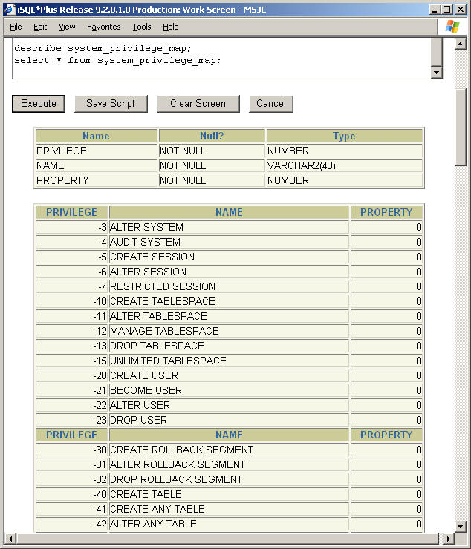
Module 14: DCL Page K-2: Data Dictionary
System_privilege_map
Description table for privilege type codes. Maps privilege type numbers to type names

Slide 50
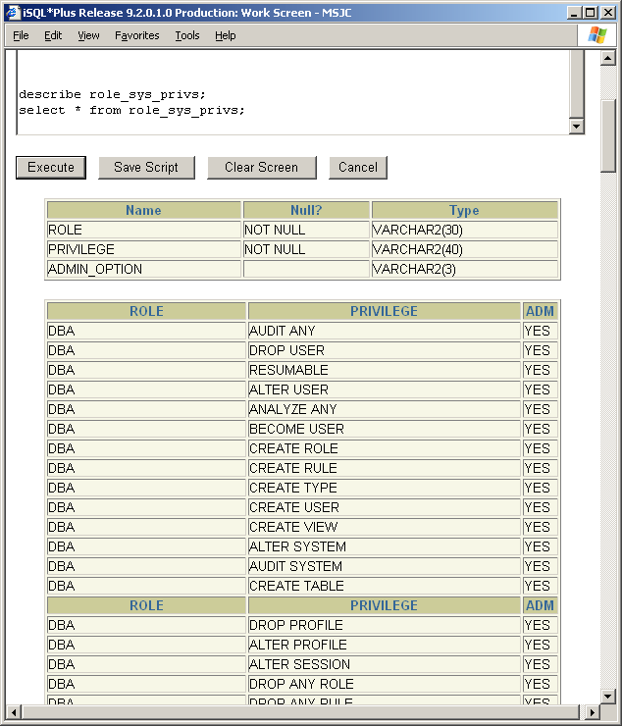
Module 14: DCL Page K-3: Data Dictionary
Role_sys_privs
System privileges granted to roles

Slide 51
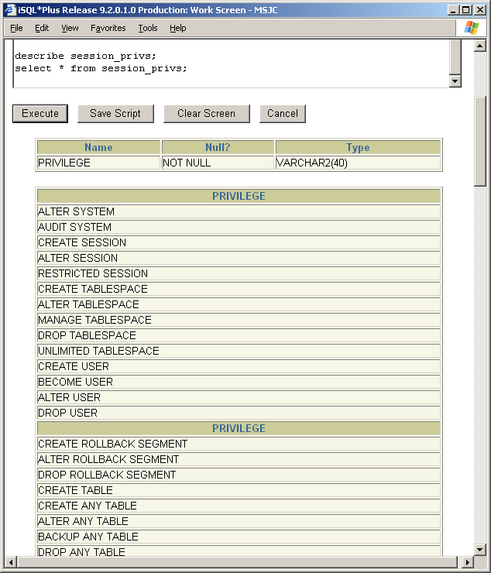
Module 14: DCL Page K-4: Data Dictionary
session_privs
Privileges which the user currently has set

Slide 52
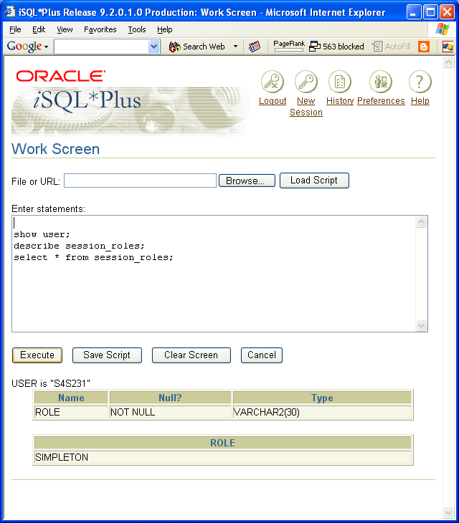
Module 14: DCL Page K-5: Data Dictionary
session_roles
Roles which the user currently has set

Slide 53
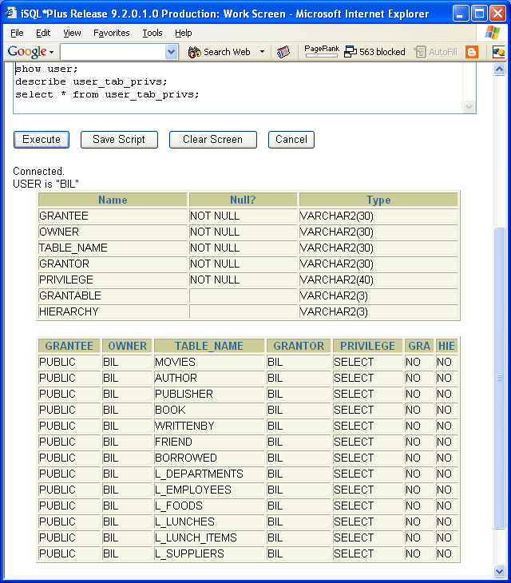
Module 14: DCL Page K-6: Data Dictionary
User_tab_privs
Grants on objects for which the user is the owner, grantor or grantee

Slide 54
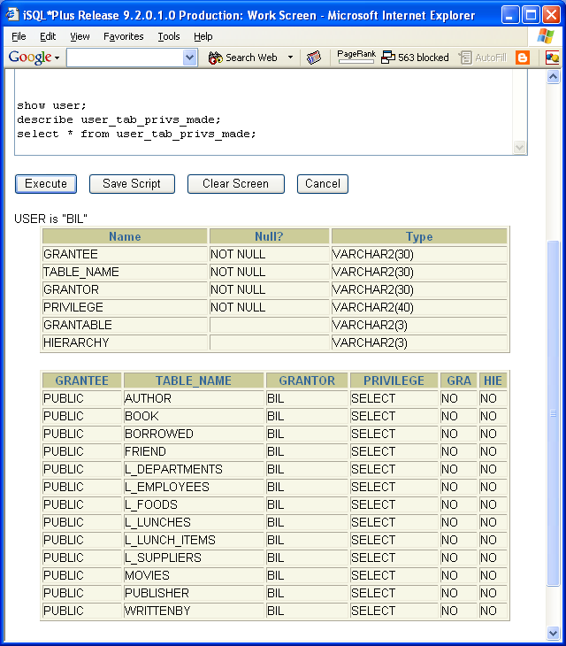
Module 14: DCL Page K-7: Data Dictionary
User_tab_privs_made
All grants on objects owned by the user

Slide 55
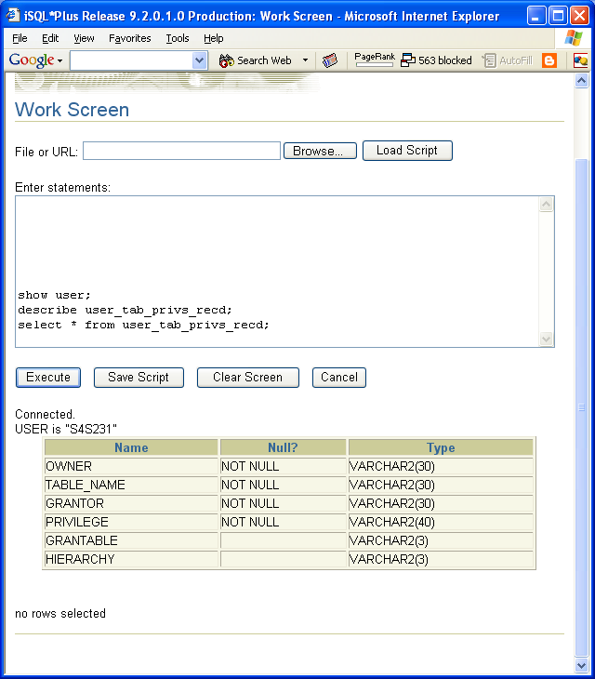
Module 14: DCL Page K-8: Data Dictionary
User_tab_privs_recd
Grants on objects for which the user is the grantee

Slide 56
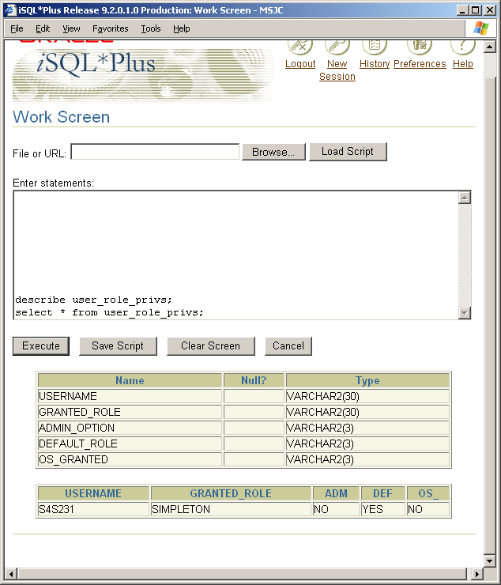
Module 14: DCL Page K-9: Data Dictionary
User_role_privs
Roles granted to current user

Slide 57
Module 14: DCL Page S-1: Summary
The purpose of database security is to protect the data.
Unless the user has been granted explicit permission to use an object, all information about that object’s existence and its structure should be kept hidden.
SQL allows the user to bestow privileges on a variety of objects, and this is where SQL has its limitations.
If the user needs to restrict access to pieces (rows) of an object (table), those security efforts require programming support above and beyond what SQL can easily provide.

Slide 58
Module 14: DCL Page T-1: Terminology
Data Control Language (DCL)
GRANT
REVOKE
privilege_type
Granularity
PUBLIC
System privileges
Object privileges
Owners / users
Administration and operations
Development
Data dictionary views

Slide 59
Module 14: DCL Page Z-1: End Notes
Please drop me an email if you noticed any errors in this module. I’d also appreciate reading your comments, criticisms, and or suggestions as to how this module could be improved.
Were there any gaps in the information that was presented (ie. ‘leaps of faith’)?
Was any section unclear?
Did I happen to do a good job? ☺
Thanks,
bil

Slide 60
That’s All

